Slide 1
The Functional Contextual Art of Therapeutic Disruption
Matthieu Villatte, PhD
Bastyr University, Seattle, USA
Notes:
This is not about solving everything in your client. This is not about taking responsibility for everything happening in client’s life. This is not about pretending everything can change though therapy. It’s about making therapy useful again.

Slide 2
Disruption?
Some definitions:
An interruption to the regular flow or sequence of something.
A forcible separation or division into parts.
Etymology:
"a rending asunder, a bursting apart, forcible separation into parts," early 15c., originally medical, "laceration of tissue," general sense from 1640s, from Medieval Latin disruptionem (nominative disruptio) "a breaking asunder," noun of action from past-participle stem of Latin disrumpere "break apart, split, shatter, break to pieces," from dis- "apart" (see dis-) + rumpere "to break,”

Slide 3
Disruption?
Definition in business and marketing:
A process of breaking conventions to accelerate movement to the future, without cutting off from the past. (Dru, 2016)

Slide 4
Therapeutic disruption?
Definition:
Breaking apart to increase flexibility?
Interrupting regular flow to ground?
Accelerating movement toward the future to connect with values?

Slide 5
We don’t need to break anything, stop moving, or move faster.
“…without cutting off from the past.”
We need to remember what we’ve forgotten.
Notes:
Transformation often come from remembering/discovering something we already know at some level

Slide 6
Best story twists are integrative

Slide 7
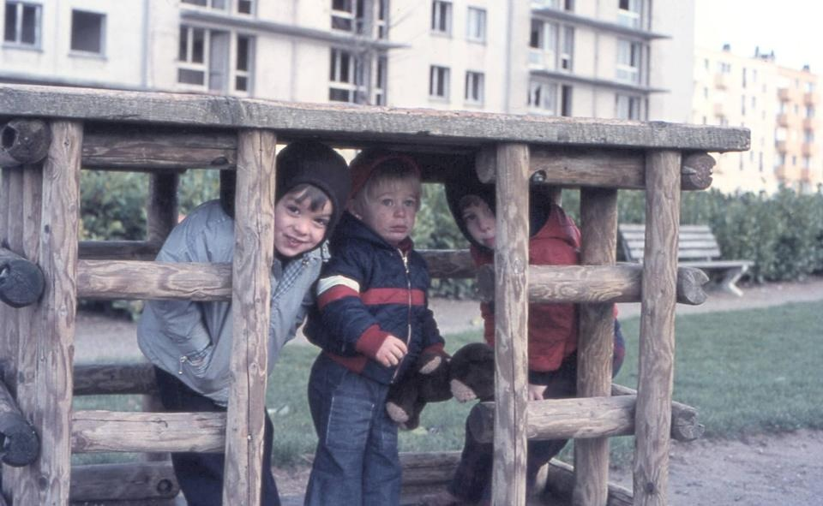
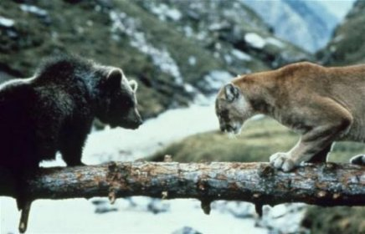
Life Big Twists

Slide 8
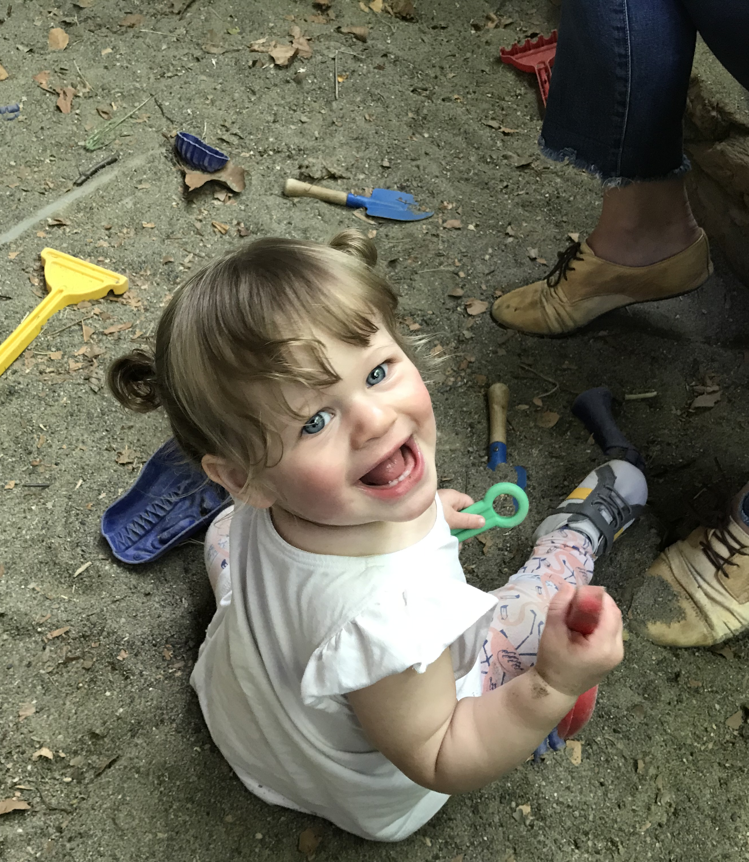
Happiness is about connecting the past, the future, and the present.
A-B-C
A: I need/want…
B: I do...
C: I get what I need/want

Slide 9
What could go wrong?
A-B-C

Slide 10
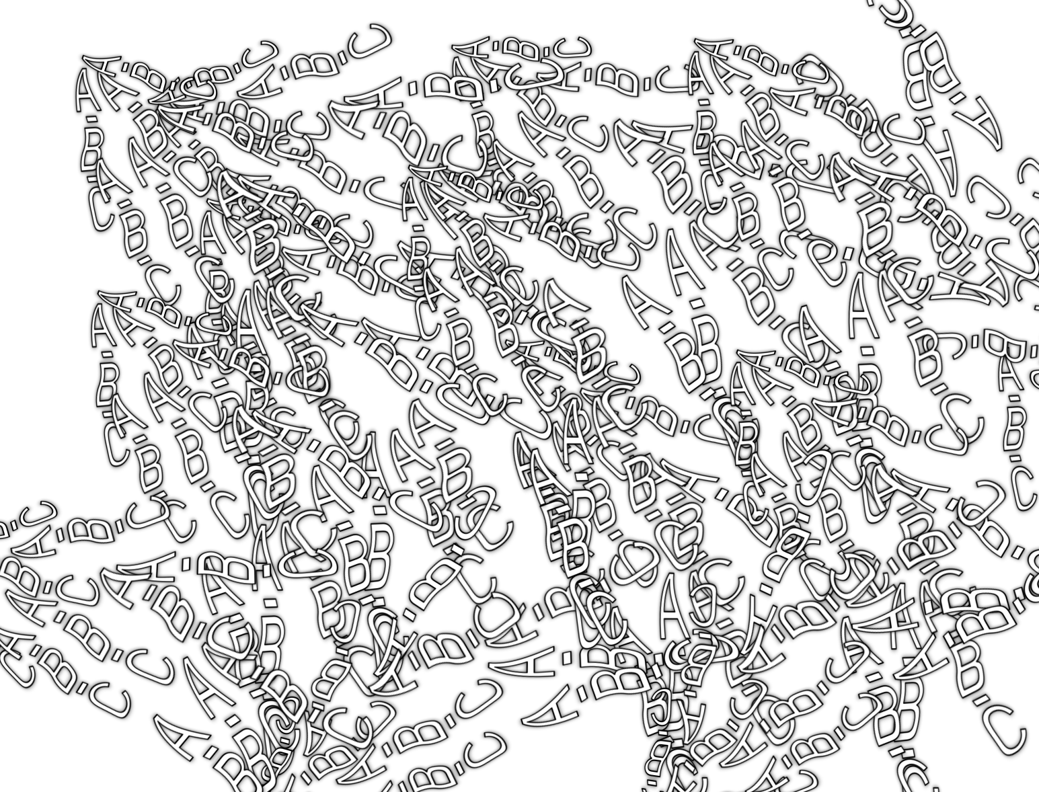

Slide 11
We need some inspiration…
https://www.youtube.com/watch?v=e8Prw9AZ9jw
Notes:
https://www.youtube.com/watch?v=e8Prw9AZ9jw

Slide 12
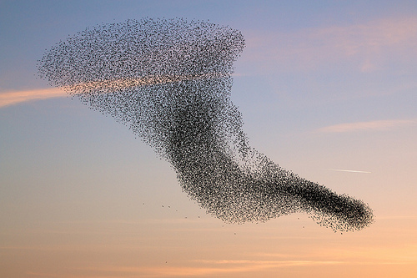
The Functional Contextual Art of Therapeutic Disruption Murmuration
Matthieu Villatte, PhD
Bastyr University, Seattle, USA

Slide 13
We need additional processes of adaptation
A-B-C
A: I need/want…
B: I do...
C: I get what I need/want
+ ?

Slide 14
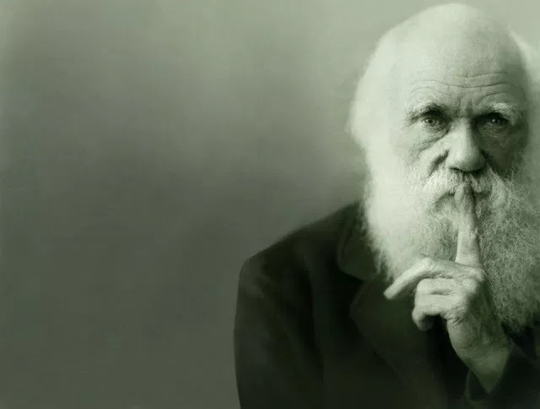
The secret of adaptation…

Slide 15
COMPETITION
SELECTION
ADAPTATION
RETENTION
VARIATION

Slide 16
Notes:
Problem is, the functioning is hard to maintain. You multiply risks of injuries and health problems. You need more energy. You can use a variety of resources, but if everybody is like that and resources are limited, there is a problem. It’s not a problem if resources are not limited, which is the case for psychology. So, how is variation and selection done in a context of absolute retention and limitless growth of characteristics and resources? It’s still hard to adapt. Why? Because endless possibilities. It’s hard to select when everything is possible (think of difficulty to choose when you are 100% free). So we try to reduce options (choose for me, pick the first thing on the menu, just leave without choosing). We regret our choices, we explore all our options to make sure we select well. We don’t know how to deal with our freedom.

Slide 17
You’re welcome.

Slide 18
We need a higher level of ABCs that orient and maintain the integrity of all ABCs

Slide 19
Processes of psychological adaptation

Slide 20
Processes of psychological adaptation
Orienting
Guiding
Assessing
INTERACTION
Contacting
Observing
Describing
INTENTION
A-B-C
Connecting
Differentiating
Transcending
TRANSFORMATION
Flowing
Changing
Adjusting
INTEGRATION

Slide 21
PSYCHOLOGICAL ADAPTATION
TRACKING
I contact, I observe, and I describe my ABCs
I orient, I guide, and I assess my ABCs
I change, adjust, and maintain the flow of my ABCs
TRANSCENDENT INTEGRATION
I connect my A-B-Cs to create transcendent reinforcement (i.e. valuing)
I connect my A-B-Cs to create a transcendent and differentiated self

Slide 22
Transformation needs flow
Solid
Very limited motion; strong internal connection but doesn’t change easily; fits only in limited contexts unless compressed but might break.
Liquid
Fluid and free motion; changes easily and maintains internal connection; fits smoothly in any context.
Gas
Random and fast motion; changes easily but has no internal connection; fits in any context but with frictions and will escape if not enclosed.
TRANSFORMATION
Flowing
Changing
Adjusting
What conditions create the flow?

Slide 23
The flow interacts in 3 dimensions
Intrapersonal
I←→ I
YOU ←→ YOU
Interpersonal
I ←→YOU
Environmental
I ←→ time, space, society, world, universe
INTERACTION
Contacting
Observing
Describing
Which dimensions are neglected?

Slide 24
The flow needs guidance
Tracking requires agency
Is the client a main character in the story?
Tracking requires orientation
What does the client want to do and for what purpose?
Tracking requires assessment
Are the client’s actual actions oriented toward purpose
Orienting
Guiding
Assessing
INTENTION
What is missing in the story?

Slide 25
Integration is not fusion, nor compartmentalization
Integration means connection
Which ABCs are not interacting with each others?
Are client’s self and values genuinely transcendent?
Integration means differentiation
Which ABCs belong to the client? Which ABCs don’t?
What about your ABCs?
Connecting
Differentiating
Transcending
INTEGRATION
Who, where, when, how is this about?

Slide 26
Psychological Adaptation
INTERACTION
INTENTION
A-B-C
TRANSFORMATION
INTEGRATION

Slide 27
What is your usual approach with this client?
Experiential?
Didactic?
Dialectic?

Slide 28
What’s the difference?
Client: “I feel confused”
→ Experiential: “Can you describe this feeling?”
→ Didactic: “You’re probably confused because there is a lot going on in your life”
→ Dialectic: “I think confusion can be useful sometimes. What do you think of this idea?”

Slide 29
Experiential approach…
Encourages contact with contingencies (ABCs)
Encourages observation of contingencies (ABCs)
Encourages description of contingencies (extraction of rules)
Notes:
ACT, FAP, EFT

Slide 30
Didactic approach…
Provides descriptions of contingencies (gives rules)
Can encourage contact with contingencies
Can encourage observation of contingencies
Notes:
CBT, DBT

Slide 31
Dialectic approach…
Encourages comparison and extraction of rules
Can encourage contact with contingencies
Can encourage observation of contingencies
Notes:
REBT, DBT, CT

Slide 32
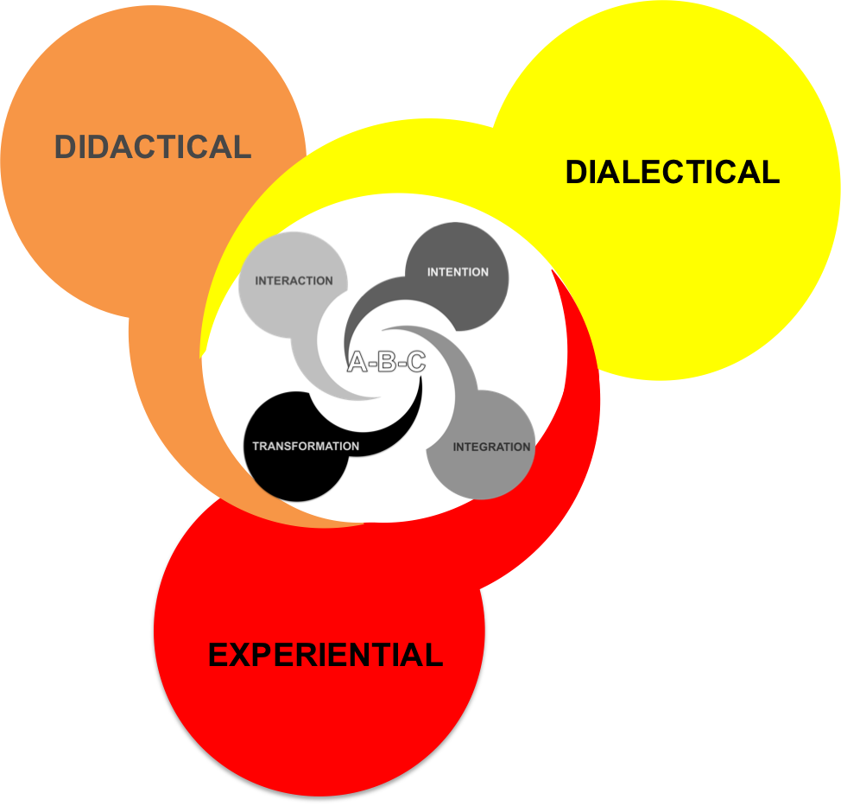
What approach might be useful to apply with this client? Can you be more fluid?

Slide 33
Happiness is about integrating the past, the future, and the present.
A B C
Treat your B like a C, and your C like an A
Notes:
A: opportunity to connect with my values
B: I connect with my values
C: opportunity to connect with my values

Slide 34
The Functional Contextual Art of Therapeutic Disruption Murmuration
Matthieu Villatte, PhD
Bastyr University, Seattle, USA

